Slide 1

No venture, no success – theorising business start-ups in the informal economy during economic crisis and their longevity in Nigeria
Eghosa Igudia (De Montfort University, UK); Rob Ackrill (Nottingham Trent University, UK) & Justin Webb (Beck College of Business, Charlotte, NC)

Slide 2
What this session is about
To provide empirical evidence on economic crisis-entrepreneurship-informal economy nexus.
To extend theory on economic crisis and entrepreneurship in the informal economy.
Specifically, to show that:
- More business ventures are created during economic crisis
That the businesses created are not just stop gaps, but have longevity
Policymakers can take advantage of it as another ammunition to stimulate the economy for growth, especially in countries of the Global South

Slide 3
Introduction - Economic crisis, entrepreneurship & the informal economy
Economic crisis:
  Rising in frequency and intensity. In this research, it refers to periods of negative economic growth, otherwise called ‘recession’;
  a period in the economic cycle characterised by falling outputs, commodity prices, financial flows, trade, capital and aids flows, and a rising unemployment, government austerity measures etc (Stavropoulou and Jones, 2013).
  Generally, periods of economic crisis are characterised by large and growing informal economy.
Entrepreneurship
  Neoliberal-Modern-city-influenced policies have increased challenges for small businesses, and pushed many into setting-up business ventures in the informal economy, with many remaining in businesses for a long time - longevity.
  Entrepreneurs are self-employed individuals who start a new business. Williams and Nadin (2010: 362-363) define informal entrepreneur as ‘someone actively involved in starting a business or is the owner/manager of a business that is less than 42 months old’. This makes the age of a business venture important when deciding whether the owner is an entrepreneur or otherwise.
  Moreover, we are interested in business longevity. Reflecting on Schumpeter’s words, convention puts the transition from entrepreneurship to running a business at 42 months (GEM, 2020).
Informal economy:
  The informal economy involves the production of legal goods and services (i.e. excluding narcotics etc.), which contributes to total economic activity in a country, but lie outside the purview or capture of official statistics (synonyms in the literature include ‘unreported economy’ and ‘untaxed economy’).
  Such economic activity includes ‘all income-earning activities that are not regulated by the state in social environments where similar activities are regulated’ (Castells and Portes, 1989: 12)
  The informal economy ‘comprises more than half of the global labour force and more than 90% of Micro and Small Enterprises (MSEs) worldwide.

Slide 4
Economic crisis, entrepreneurship & the informal economy – what we know so far
Economic crisis is known to permanently damage a country’s productivity, employment opportunities, cause severe inequality, and potentially drives people into the informal economy.
World Bank (2022) notes that whilst economic crisis/recession affects all citizens, worse hit are the low-skilled workers, who take about a decade to recover from the effect of economic recession.
The informal economy plays a critical role during periods of economic crisis. It is countercyclical and acts as excess labour buffer, especially in countries of the Global South (Galí and Kucera, 2003; Konon et al., 2018).
It offers the only viable alternative to formal employment (Xaba et al., 2002).
Workers in the formal (public and private) economy who are affected, especially in countries with limited welfare systems, are likely to face greater pressure to seek earning opportunities in the informal economy (Becker, 2004; Hart, 2012).

Slide 5
Economic crisis, entrepreneurship & the informal economy – what we know so far
Most individuals/businesses pushed into the informal economy during economic crisis often continue in the informal economy, at least partly, even after the economic crisis (Bureau and Fendt, 2011).
Why? Need for further theorising, especially in developing country context. Important questions:
  If individuals were initially pushed into the informal economy (survival or necessity motives), what is their reason for continuing in the informal economy?
  Do their operations in the informal economy, and in particular, the way they have managed the economic crisis and policy-related challenges enabled them to develop entrepreneurial qualities?
  Are individuals who enter into the informal economy for survival reasons (necessity entrepreneurs) able to transition to opportunity-seeking entrepreneurs?
Further, research in this area has focused on developed, ex-communist and emerging economies (Williams and Nadin, 2010) – less attention has been paid to understanding the entrepreneurial nature of economic activity in the informal economy of developing countries.
Yet, in developing countries the informal economy is relatively large:
  89% of the labour force in Ghana, over 50% of the labour force in Kenya and Uganda, and 43% of urban employment in South Africa and Zambia (Xaba et al., 2002); 93% of all new jobs created in Africa in the 1990s (Chen, 2001; Verick, 2006). (Rivera-Santos et al., 2015)

Slide 6
The Gap - Economic crisis, entrepreneurship & the informal economy
Moreover, economic crisis and the informal economy have been discussed via the lens of capitalism.
Hart (2012, p.1) refers to it as the dominant economic thought of “state management of the economy and the market decades of one-world capitalism” of the 1970s through to the 2008 financial crisis.
Arguably, the neoliberal ideology which started as privatisation of public interest has now added to it a mixture of power and money, and the free market system has become both the cause and major culprit.
This has led to the informalisation of the world, brought about the collapse of state controls over the economy, and in particular the national capitalism that was the hallmark of the twentieth century, but is now gradually crumbling.
Capital accumulation channel may provide anecdotal explanation to why there is longevity for business ventures set-up in the informal economy during economic crisis, but this needs empirical validation. Moreover, the jury is still out on developing countries, where a high proportion of the citizens operate in the informal economy without necessarily having the resources to accumulate capital. Thus, there is need for theorising developing country experience.
Our paper contributes to this area using cross section data collected over a decade from Nigeria at five irregular intervals.

Slide 7
Theory and methods – filling the gaps
  The push/necessity and pull/opportunity entrepreneurship theories adopted and extended.
  Push and pull concepts: individuals working for themselves in the informal economy (pull) and those working for someone else (push); those from better-off communities (pull) and those from deprived communities (push); developed countries (pull) and developing countries (push); women (push) and men (pull) (Williams et al., 2015: 297; Williams and Williams, 2012).
  By linking crisis to informality, we are also extending research on poverty alleviation as a motivation for entrepreneurial activity (Alvarez and Barney, 2014; Sutter et al., 2019).
  Our results thus offer new insights into the type of economic activity being undertaken by different displaced workers, following economic crises.
  Data.
  We employ survey data collected over a decade at five irregular points: 2012, 2017, 2019, 2021 and 2022.
  Moreover, we carry out in-depth analysis with the data collected in 2012 and 2021.
  2012 data was collected via a survey conducted across five of Nigeria’s six geopolitical zones over May-August 2012, using a structured questionnaire and stratified random sampling method. 641 sample achieved from both FIWON and non-FIWON workers. Data collected spanned both the SAP and global economic crises periods.
  Unlike the 2012 nationwide survey, the 2019-2022 data collection took place only in Lagos – one of 36 states in Nigeria, but the fastest growing megacity and biggest commercial centre in Africa.
  The 2017, 2019 and 2021 surveys took place in at least 10 of the 20 local governments areas in Lagos, and generated a respective sample size of 600, 529, and 450. Using different literature defined criteria, with specific focus on generating data relevant for answering the questions raised in this research, the useable data generated from the respective sample includes 160 for 2017, 529 for 2019, and 256 from 2021.
  Finally, the 2022 survey saw us sample the entire 20 local government areas in Lagos state, generating a total of 1,725 responses.

Slide 8
filling the gap – research hypothesis
Two research questions:
  what impact have economic crises had on informal entrepreneurship in Nigeria?
  Given the policy relevance of whether such entrepreneurship activity is merely a temporary stopgap in the face of economic downturns in the formal sector, or whether it represents the starting point for longer-term Schumpeterian business activity, do informal businesses established during times of economic crisis endure in the long term?
We answered these questions by testing the following hypothesis:
H1: survival reason (necessity entrepreneurship) is a driver of business start-ups in the Nigeria informal economy during economic crisis
H1b: pull factors (corruption, tax burden) are drivers of business creation and expansion in the Nigerian informal economy
H2: opportunity-seeking reasons (opportunity entrepreneurship) is a driver of the expansion of the Nigerian informal economy
H2b: pull factors (autonomy, time on main job etc) drive business expansion, entrepreneurship in the Nigerian informal economy

Slide 9
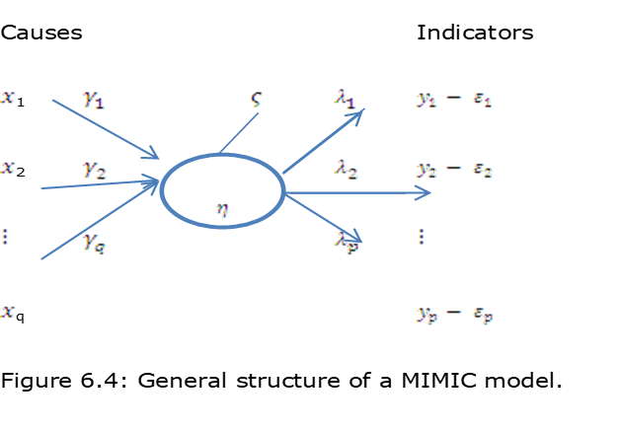
Method - facts about MIMIC models
Multiple indicators, multiple causes (MIMIC) model is a type of SEM which combines several indicators and causes in a simultaneous analysis.
While causes explain origin or determinant of a latent variable, indicators represent their possible outcome.
MIMIC models have advantage over multiple regression models, as the latter can only solve one dependent and multiple independent variables at a particular time.
A MIMIC model is specified as:
M = Df + E .......................(1)
D = gM + U ......................(2)
d = Pf + V .........................(3)
Where: M=latent variable, D=vector coefficient, f=vector that can cause latent variable, E=error term. For Eq. (2), D=multi-indicator variable vector, g=vector of regression coefficients, U=vector of white noise disturbance, Qu=txt covariance matrix. For Eq. (3),P=gD, unit ranked matrix, V=gE+U, error term for Eq.1+2.
Notes:
Causal factors: Unemployment (UNEMP) – scale data, ranging from 1-10; Autonomy/self-employment (AUTO) - scale data, as UNEMP; Corruption or business freedom (BF) – scale data, ranging from 1-5; Tax burden (LTAX) - scale data, as UNEMP; Survival (SURV2) - scale data, as UNEMP; Time on main job (TOMJ) - scale data, as UNEMP; Indicators (scale data, ranging from 1-5); Helpful (HPF); Wealth (WTH); Growth (GROT).

Slide 10
Findings
From next slide!

Slide 11
Data description – business age
Table 1: Age Distribution of Business Start-up, % Share by Age Group:
 | Reported Age of Business in years
 | 1-5 | 6-10 | 11-15 | 16-20 | 21-27 | >27
All participants | 37.1 | 11.8 | 14.5 | 7.5 | 19.4 | 9.7
Non-FIWON Members | 53.5 | 13.8 | 11.2 | 5.2 | 7.8 | 7.8
FIWON Members | 9.9 | 8.5 | 19.7 | 11.3 | 38 | 12.7

Slide 12
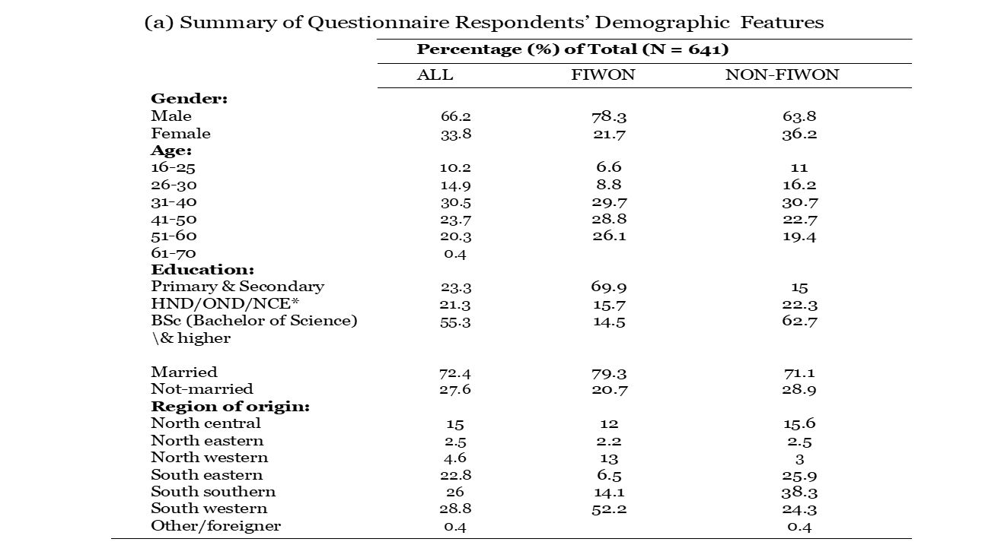
Data description & summary statistics

Slide 13
Data description & summary statistics

Slide 14
Mimic result
Table 4: Mimic result
Notes:
CMIN, CFI, and RMSEA are the key diagnostic statistics. Moreover, Bentler (1992), among others, recommends the CFI as the index of choice, because the IFI and CFI are not sample-biased. Our model posts 0.932 and 0.922 for IFI and CFI, respectively. Byrne (2010, 78) suggests that a CFI value greater than 0.9 (Bentler, 1992) or a value close to 0.95 (Hu and Bentler, 1999) represent ‘a well-fitting model’. The same is true for IFI. Our results satisfy both criteria. The badness-of-fit measure, which by rule should not exceed 0.05 for a well-fitting model, is also statistically significant. The RMSEA, with a maximum value of 0.03, shows a well-fitting model. In addition to the overall fit of the model, the results show that all (Causal and Indicator) variables are significant at the 5% level, and are consistent with theory. The model in is thus suitable as the basis for our analysis.

Slide 15
Robustness check - Multinomial results for business start-up year and causal variables.
Table 5: Robustness check – multinomial analysis
Notes:
Note: ***, **, * = significant at 1%, 5% and 10% levels; p-values and standard error in ( ) and [ ] parentheses respectively; OE – opportunity entrepreneurship; NE – necessity entrepreneurship; ME – mixed entrepreneurship; ^ - model capturing the effect of FIWON and non-FIWON; FIWON-G - FIWON GEC capturing direct relationship between GEC and SAP.

Slide 16
Discussion & contributions
MIMIC results show that the factors determining the origin and expansion of Nigeria’s informal economy are UNEMP (no other job for participants), AUTO (desire to be autonomous or self-employed), BF (corruption of government officials and agencies), LTAX (participants’ desire to pay less tax), SURV (participants’ need to survive), and TOMJ (time spent on main job/business activity).
All factors except AUTO, have the expected sign. This means that an increase in the size of any factor except AUTO, will lead to an increase in the size of the informal economy in Nigeria.
Specifically, a unit rise in unemployment, corruption, tax avoidance, survival, and time on main job trigger a 0.094, 0.172, 0.075, 0.219, and 0.039 percentage point expansion, respectively.
The biggest influence comes from the need for survival, as hypothesised: economic crisis pushes individuals into the informal economy.
  This thus confirm our first hypothesis, H1: survival reason (necessity entrepreneurship) is a driver of business start-ups in the Nigeria informal economy during economic

Slide 17
Discussion & contributions
In magnitude, Survival is followed by Corruption.
This confirms hypothesis 1b; H1b: pull factors (corruption, tax burden) are drivers of business creation and expansion in the Nigerian informal economy.
In addition, the positive sign on TOMJ reflects entrepreneurial responses to a situation that individuals find themselves in, having initially been pushed there,
and thus confirms hypothesis 2; H2: opportunity-seeking reasons (opportunity entrepreneurship) is a driver of the expansion of the Nigerian informal economy.
These findings align with those of Williams and Williams (2012: 678) for deprived English neighbourhoods; that the ‘reality of entrepreneurial motivations [is that it] can change several times between the initial genesis of an idea and the launch of a business venture […hence, it is not] driven solely by perceptions of their originating condition’.

Slide 18
Discussion & contributions
Finally, the negative sign on AUTO suggests that an increased desire for autonomy or self-employment leads to a decline in the size of the informal economy.
At first glance this appears to be counter-intuitive, contradicting the established positive relationship in the literature (Gerxhani, 2004).
However, in times of extreme economic difficulty, individuals need to prioritize Survival over Choice and Autonomy when making initial, critical, economic decisions.
Thus, the push of survival dominates the pull of autonomy amongst our survey respondents, implying that a negative sign on autonomy is consistent with survival being our most important (push) factor for participation in the informal economy during economic crisis.
These findings are consistent with those of Simón-Moya et al. (2016: 168) who note that, regarding SME survival in Spain, ‘Contrary to intuition or common sense, empirical results show that probability [sic] of firm survival for our sample was higher during crisis, when growth rates declined and unemployment rates rose rapidly’.
We therefore conclude that, whilst not the dominant force, time on main job influences expansion of business in the informal economy, and thus confirm hypothesis 1b, H2b: pull factors (autonomy, time on main job etc) drive business expansion, entrepreneurship in the Nigerian informal economy.

Slide 19
Conclusions
Through this research we have sought to understand how economic crisis affects entrepreneurship in the informal economy, through the establishment of new businesses. We have also sought to understand whether these activities are merely short-term palliatives to economic crisis, or whether these start-ups become long-lived businesses. Our data, collected via a questionnaire administered across Nigeria, allow us to analyse empirically the impact of two periods of economic crisis – the SAP introduced in 1986 and the 2007-09 GEC.
Our data indicate far more business start-ups in Nigeria’s informal economy during periods of economic crisis.
We also find that a higher-than-average number of businesses established during the first economic crisis (SAP era) are still operating today.
Our results indicate, first, that push factors dominate initial reasons for venturing into a business in the informal economy in Nigeria. However, other factors emerged over time to retain those businesses and individuals in the informal economy.
Thus, we find clear evidence of these businesses’ longevity; with business survival rates showing peaks in informal economy entry at times when survival pressures were greatest. When faced with economic crisis, the informal economy offers not only a means of survival, but an environment for the flourishing of business activity that long outlasts the period of crisis.
These findings offer important messages for policymakers.

Slide 20
Conclusions
Thank you
Questions & answers
Suggestions to improve the paper

